Slide 1

Module 3
Dimension Reduction
Notes:
Guidelines
Use section headers to chunk content in your presentation.
Use the same style of section header throughout your presentation.
Keep your title to no more than 2 lines.

Slide 2
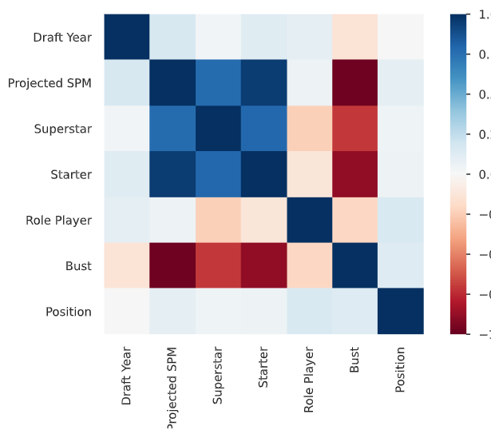
Reducing Dimensionality for Categorical Variables
Notes:
Guidelines
Use a title slide at the beginning of your presentation. There are 9 variations of title slides to choose from.
If you will have a series of slideshows, we recommend using the same style of title slide for each presentation.
Keep your title to no more than 2 lines.
Do not change the font style or font size of the title or subtitle.

Slide 3

Reducing the Number of Levels
Reducing the number of distinct levels of a categorical variable.
Keeping only the most common levels (levels with highest fractions)
Combine similar levels
Use model to determine most important levels

Slide 4
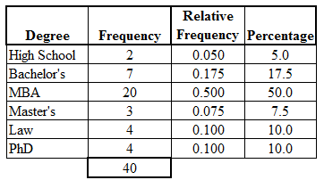
Keeping the most common levels
Keep the categories that have the largest proportions of obs.

Slide 5
Python
Notes:
Guidelines
Use a title slide at the beginning of your presentation. There are 9 variations of title slides to choose from.
If you will have a series of slideshows, we recommend using the same style of title slide for each presentation.
Keep your title to no more than 2 lines.
Do not change the font style or font size of the title or subtitle.

Slide 6
Combine Similar Levels
Combine because they may have similar characteristics.

Slide 7
Python
Notes:
Guidelines
Use a title slide at the beginning of your presentation. There are 9 variations of title slides to choose from.
If you will have a series of slideshows, we recommend using the same style of title slide for each presentation.
Keep your title to no more than 2 lines.
Do not change the font style or font size of the title or subtitle.

Slide 8
Use Model to Determine Levels to Keep
Keep the levels with most predictive power.

Slide 9
Python
Notes:
Guidelines
Use a title slide at the beginning of your presentation. There are 9 variations of title slides to choose from.
If you will have a series of slideshows, we recommend using the same style of title slide for each presentation.
Keep your title to no more than 2 lines.
Do not change the font style or font size of the title or subtitle.

